Slide 1
VLSI DESIGN
23EC2211A
Dr. Vijay Rao Kumbhare
Assistant Professor (ECE)
K L University, Hyderabad

Slide 2
Contents
Previous Lecture
Course introduction with Pre-requisite
Course handout and evaluation pattern
CH, Evaluation Plan, Formative Assessment
MOSFET BASICS:-
MODES; MOSFET as switch;
Symbols; VI Characteristics

Slide 3
Course Introduction and Objective
Course Rationale :
The purpose of this course is to develop a strong foundation and skills in analysis and design of low power VLSI circuit.
Understand the fundamentals of VLSI circuit design, including device physics, transistor models, and circuit analysis techniques (CO-01)
Gain proficiency in CMOS layout design rules leading to successful fabrication of VLSI circuits. (CO-02)
Acquire hands on experience in different industry level VLSI CAD tools like CADENCE through successful back annotation of VLSI circuits. (CO-03)
Develop skills in optimization techniques including layouts, area reduction through transistors reduction and performance (delay and power) enhancement. (CO-04)
Explore advanced topics in full custom VLSI techniques like static and dynamic memory design. (CO-05)

Slide 4
Course Content: VLSI DESIGN (22EC2211A)
L-T-P-S | 4-0-4-2 | Credit | 6.5
Pre-requisites | NIL | Contact Hours | -
Syllabus
MOS Transistor Theory: Introduction to the metal oxide semiconductor (MOS) structure, Long-channel I-V characteristics, C-V characteristics, non-linear I-V effects, and DC transfer characteristics. CMOS Process Technology: Fabrication process flow- basic steps, the CMOS n-Well process, layout design rules, stick diagram, full-custom mask layout design.
Circuit Characterization and Performance Estimation: : Introduction, Delay Estimation, Logical effort and transistor sizing, power dissipation, interconnect, design margin, reliability, scaling. MOS Inverters: Resistive load, depletion load, enhancement load, CMOS inverter, Static and Dynamic characteristics.
Combinational CMOS Logic Circuits: MOS logic circuits with depletion nMOS loads, MOS Inverter - Static Characteristics, Switching Characteristics, and Interconnects effects, CMOS logic circuits, complex logic circuits, CMOS transmission gates (pass gates), ratioed, dynamic and pass transistor logic circuits.
Sequential MOS logic circuits: Behavior of bi-stable elements, SR latch circuits, clocked latch and flip-flop circuits, CMOS D-latch, and edge-triggered flip-flop. Timing path, Setup time and hold time static, an example of setup and hold time static, setup and hold slack, clock skew and jitter, Clock, reset, and power distributions. Memory Design, SRAM, DRAM structure, and implementations.

Slide 5
Text and Reference Books
Text Books
N. H. E. Weste, and C. Harris, Principles of CMOS VLSI Design: A System Perspective, 3rd Edition, Pearson Education, 2007
Kang, Sung Mo, and Yusuf Leblebici, CMOS digital integrated circuits, Second edition, MacGraw-Hill, 2003
Debaprasad Das, VLSI Design, OXFORD Higher Education.Jacob Baker, “CMOS Mixed Signal Circuit Design”, John Wiley, (2008)
Jan M. Rabaey, “Digital Integrated Circuits” Pearson Education, 2003
Reference Books
Douglas A. Pucknell, and Kamran Eshraghian - Basic VLSI design, Prentice-Hall, 1994.
J. Rabaey, A. Chandrakasan, and B. Nikolic, Digital Integrated Circuits: A Design Perspective, 2nd Edition, Prentice Hall, 2004.

Slide 6

EVALUATION PLAN

Slide 7
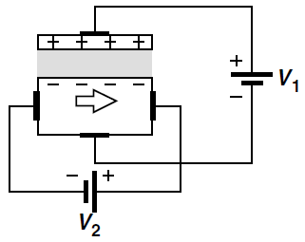
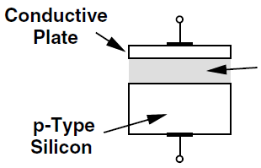
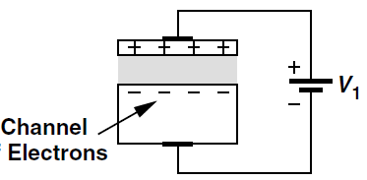
MOSFET Basics
Any voltage-controlled current source can provide signal amplification.
MOSFETs also behave as controlled sources but their characteristics are different from those of bipolar transistors.
A simple geometry consisting of a conductive (e.g., metal) plate, an insulator (“dielectric”), and a doped piece of silicon.
Such a structure operates as a capacitor
Figure 1 (a) Hypothetical semiconductor device, (b) operation as a capacitor, (c) current flow as a result of potential difference.

Slide 8
MOSFET Capacitor
When a negative voltage is applied to the gate
Vg < 0
Accumulation

Slide 9
MOSFET Capacitor
When a small positive voltage is applied to the gate
Vg > 0
Depletion
Depletion

Slide 10
MOSFET Capacitor
When a positive voltage above threshold voltage is applied to the gate
0 > Vg > V_{th}
Channel
Inversion

Slide 11
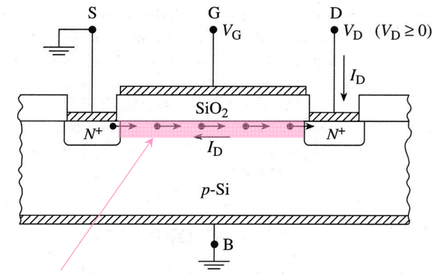
MOSFET
Metal Oxide Semiconductor Field Effect Transistor
Four terminal device: Source (S), Gate (G), Drain (D), and Body (B).
Flow of charge from “Source” to “Drain” is controlled by the “Gate” voltage.
Fig. 1 Basic Structure of MOSFET
Control by the Gate voltage is achieved by modulating the conductivity of the semiconductor region just below the gate. This region is known as the channel

Slide 12
Mode of Operation
Depletion mode and enhancement mode.
Depletion mode: The transistor requires the Gate-Source voltage (V_{GS}) to switch the device “OFF”. The depletion-mode MOSFET is equivalent to a “Normally Closed” switch.
Enhancement Type: The transistor requires a Gate-Source voltage (V_{GS}) to switch the device “ON”. The enhancement-mode MOSFET is equivalent to a “Normally Open” switch.
The formation of a channel between the source and drain can act as N-type or P-type MOSFET depending on the carriers doped in the channel region.

Slide 13
N-channel vs. P-channel
NMOS
PMOS
P+ poly-Si
N+ poly-Si
N+
N+
P+
P+
p-type Si
n-type Si
For current to flow, V_{GS} > V_{T}
to form n-type channel at surface
For current to flow, V_{GS} < V_{T}
to form p-type channel at surface
Enhancement mode: V_{T} > 0
Enhancement mode: V_{T} < 0
Depletion mode: V_{T} < 0
Transistor is ON when V_{G}=0V
Transistor is OFF during - V_{G}
Depletion mode: V_{T} > 0
Transistor is ON when -V_{G}
Transistor is OFF during +V_{G}
Note: V_{T} denotes the threshold voltage, some textbook uses the V_{t} notation.

Slide 14
Table 1 Types of MOSFET having N-type and P-type channel
Devices | Operating State | Applied Voltage as Gate terminal for
 |  | N- channel | P-channel
Depletion type | ON | – V_{G} Turns OFF | +V_{G} Turn OFF
Enhancement type | OFF | + V_{G} Turns ON | – V_{G} Turn ON
(a)
(b)
Fig. 2 Symbolic representation of n-channel/p-channel MOSFET under (a) depletion condition and (b) enhancement condition.

Slide 15
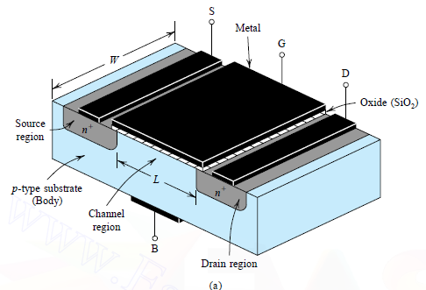
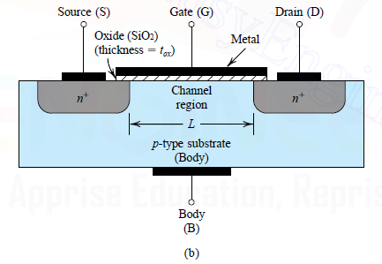
N-channel Enhancement type MOSFET
Perspective View
Cross-sectional View
Fig. 3 Physical structure of n-channel enhancement MOSFET (a) perspective view and (b) cross-sectional view.

Slide 16
N-channel Enhancement type MOSFET
The gate electrode is placed on top of a very thin insulating oxide (SiO₂) layer.
There are a pair of small n-type regions just under the drain and source electrodes.
If apply a +Ve voltage to gate (G), will push away the “holes” inside the p-type substrate and attracts the moveable electrons in the n-type regions under the source and drain electrodes.
Increasing the +Ve voltage of gate (G) pushes the p-type holes further away and enlarge the thickness of the created channel.
As a result, source to drain current increases-this is why this kind of transistor is called as enhancement mode device.
Fig. 3 Cross-sectional view of n-channel enhancement MOSFET

Slide 17
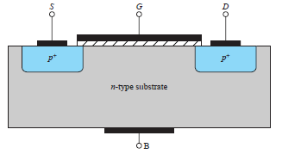
P-channel MOSFET
These behave in a similar way, but they pass the current when a –Ve gate voltage creates an effective p-type channel layer under the insulator.
All the voltage and current sign are reversed as compared to N-channel MOSFET.
The free charges that moves from end to end are positively charged (holes).
Fig. 4 Cross-sectional view of p-channel enhancement MOSFET
The PMOS and NMOS transistor are said to be complementary devices.

Slide 18
Operation of N-channel enhancement MOSFET
For an n-channel device with its source and substrate grounded (i. e., V_{S}=V_{B}=0 V).
For any value of V_{DS}: (Operation with zero gate voltage)
when V_{GS} <0 (accumulation), the source to drain path consists of two back to back diodes.
One of these diodes is always reverse biased regardless of the drain voltage polarity.
V_{DS} ≥ 0 V
when 0<V_{GS} <V_{T} (depletion), there is a deficit of electrons and holes making the channel highly resistive.
No Drain current can flow.
Fig. 5 n-channel enhancement MOSFET at zero gate voltage.

Slide 19
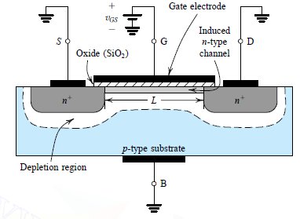
Consider now the Inversion case:
First, V_{DS} = 0:
when V_{GS} > V_{T} , an induced n- type region, an “inversion layer”, forms in the channel and “electrically connects” the source and drain
The channel is created by inverting the substrate surface from p-type to n type. Hence the induced channel is also called an inversion layer.
The value at which a sufficient number of mobile electrons accumulate in the channel region to form a conducting channel is called the threshold voltage (V_{T}).
V_{T} ranges from 0.3 to 1V.
Fig. 6 n-channel enhancement MOSFET at positive gate voltage.

Slide 20
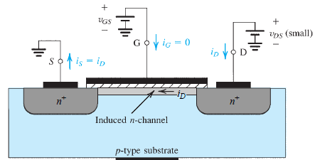
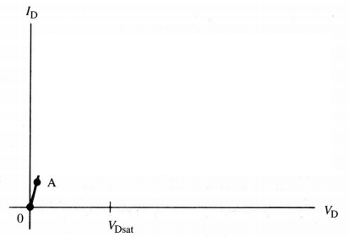
Inversion case, V_{GS} > V_{T} (continued): (Applying a small V_{DS})
When V_{DS} >0 , the induced n-type region allows current to flow between the source and drain.
The induced channel acts like a simple resistor. Thus, this current, I_{D}, depends linearly on the Drain voltage V_{D}. This mode of operation is called the linear or “triode”* region.
Fig. 8 Drain current (I_{D}) verses drain voltage (V_{D}) when in the linear or “triode”* region.
Fig. 7 n-channel enhancement MOSFET with V_{GS}>V_{T} and a small V_{DS} applied

Slide 21
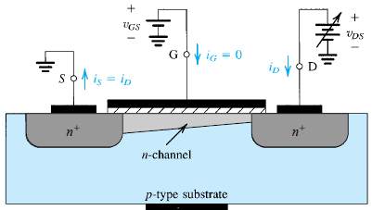
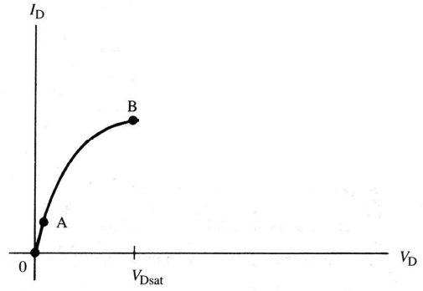
Inversion case, V_{GS} > V_{T} (continued):
When V_{DS} increases a few tenths of a volt (>0):
The depletion region near the drain widens (N+ drain is positively biased – i.e. reverse biased with respect to the substrate).
The electron concentration in the inversion layer near the drain decreases as they are “sucked out” by the drain voltage.
Channel conductance decreases resulting in a drop in the slope of the I_{D} – V_{D} curve.
Fig. 9 n-channel enhancement MOSFET with V_{GS}>V_{T} and increased V_{DS} .
Fig. 10 Drain current verses drain voltage for increasing V_{DS} (still in the “linear” or triode region).

Slide 22
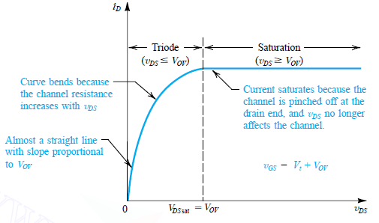
Inversion case, V_{GS} > V_{T} (continued):
The inversion layer eventually vanishes near the drain end of the channel. This is called “Pinch-Off” and results in a Flat I_{D}-V_{DS} curve.
Fig. 11 The drain current versus the drain-to source voltage for an enhancement type NMOS transistor operated with V_{GS}=V_{T}+V_{OV.}
Where V_{T} and V_{OV} denote threshold voltage and over drive voltage, respectively.
The drain-source voltage, V_{DS}, at which this occurs is called the saturation voltage, V_{sat} while the current is called the saturation current, I_{Dsat}.

Slide 23
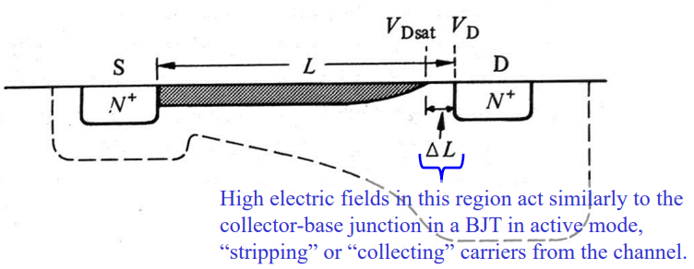
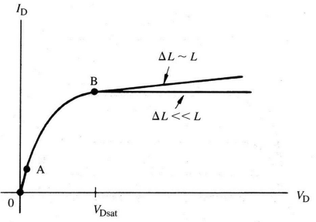
Inversion case, V_{GS} > V_{T} (continued):
For V_{DS}>V_{sat} the channel length, L, effectively changes by a value ΔL.
The region of the channel, ΔL is depleted and thus, is high resistivity.
If ΔL <<L, the voltage at the end of the channel will be constant (V_{sat} ) for all V_{DS}>V_{sat}.
I_{D} will be constant.
If ΔL ~L, the voltage dropped across the channel (V_{sat}) varies greatly with V_{DS} due to large modulations in the electric field across the pinched off region ( E=[V_{DS} -V_{sat}]/[ΔL]).
In this case, I_{D} increases slightly with V_{DS}.

Slide 24
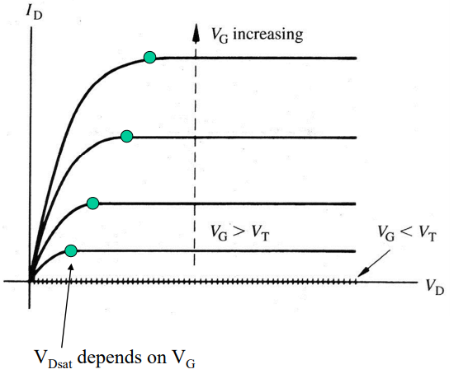
Finally,
I_{D}-V_{DS} curves for various V_{GS}:
Fig. 12 The Final drain current versus the drain-to source voltage for an enhancement type NMOS transistor.

Slide 25
The Depletion type MOSFET
Its structure is similar to that of the enhancement-type MOSFET with one important difference:
The depletion MOSFET has a physically implanted channel.
An n-channel depletion-type MOSFET has an n-type channel region connecting the n+ source and the n+ drain regions at the top of the p-type substrate.
If a voltage V_{DS} is applied between drain and source, a current I_{D} flows for V_{GS} = 0.
There is no need to induce a channel, unlike the case of the enhancement MOSFET.
The negative V_{GS} is said to deplete the channel of its charge carriers, and this mode of operation (negative V_{GS}) is called depletion mode.

Slide 26
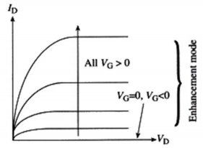
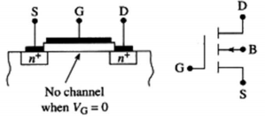
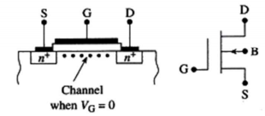
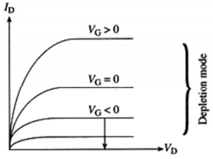
Enhancement Mode verses Depletion Mode MOSFET
N-channel MOSFET
Enhancement mode
Depletion mode
Structure
Symbol

Slide 27
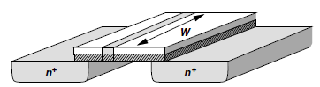
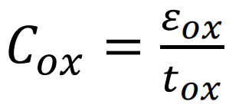
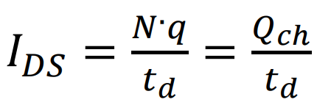
Derivation of I-V Characteristics
1. Channel Charge Density
From Q_{ch} = CV
C is the gate capacitance per unit length and V the voltage difference between the gate and the channel, then Q_{ch} is the desired charge density.
C = WC_{ox}
V = V_{GS} − V_{TH} because no mobile charge exists for V_{GS} < V_{TH}.
Q_{ch} = WCox(V_{GS} − V_{TH}).
Q_{ch} is expressed in coulomb/meter.
2. Drain Current at the linear, or triode, region.
Consider a bar of semiconductor having a uniform charge density (per unit length) equal to Q_{ch} and carrying a current I

Slide 28
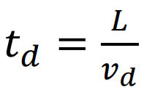
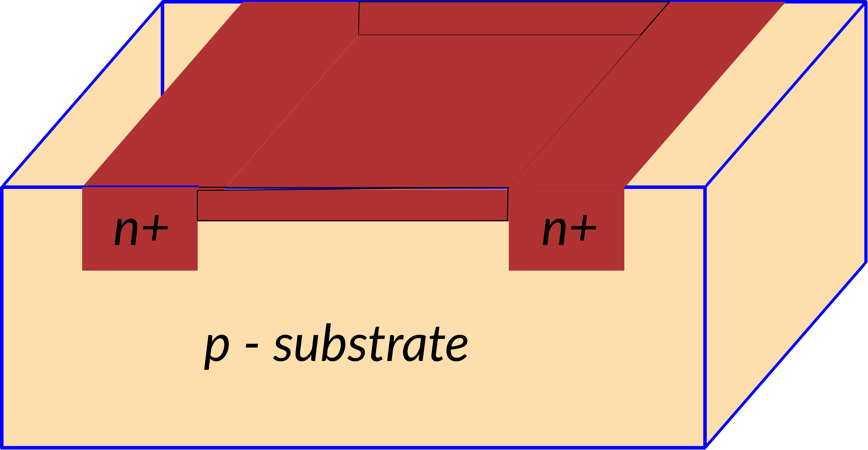
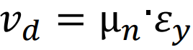
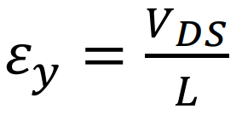
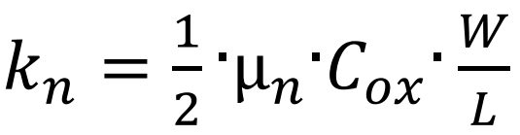
Derivation of I-V Characteristics
2. Drain Current at the linear, or triode, region. (as long as VDS kept in low level i.e VDS < VGS ‐ VTH)
Drift time, td, is directly proportional to the channel length L, and inversely proportional to the drift velocity of electrons, vd
Drift velocity, vd, is proportional to the horizontal electric field, εy, i.e.:
where µn is the electron mobility in the channel. The value of the horizontal electric field, εy, is, approximately, calculated as follows:
the following expression for IDS can be written as:
where kn is called conductivity factor for NMOS transistors. It is given by:

Slide 29
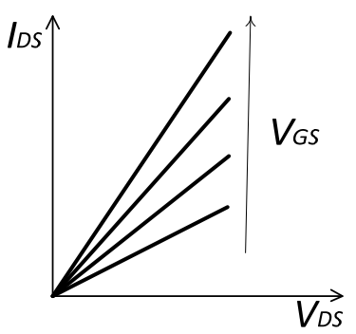
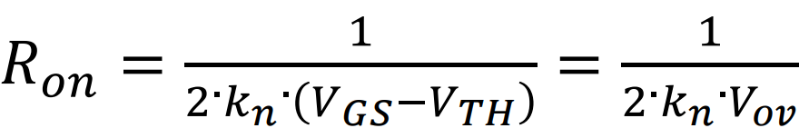
Derivation of I-V Characteristics
2. Drain Current at the linear, or triode, region. (as long as VDS kept in low level i.e VDS < VGS ‐ VTH)
(A)
The NMOS transistor operates in the linear, or triode, region, as long as VDS kept in low level i.e VDS < VGS ‐ VTH
IDS is proportional to VDS.
Fig. 1 IDS ‐VDS curves of the NMOS transistor in linear region with VGS as parameter.
Practically, in linear region, the NMOS transistor acts like a variable resistance, Ron, whose value depends on Vov. Ron is calculated as follows:
(B)

Slide 30
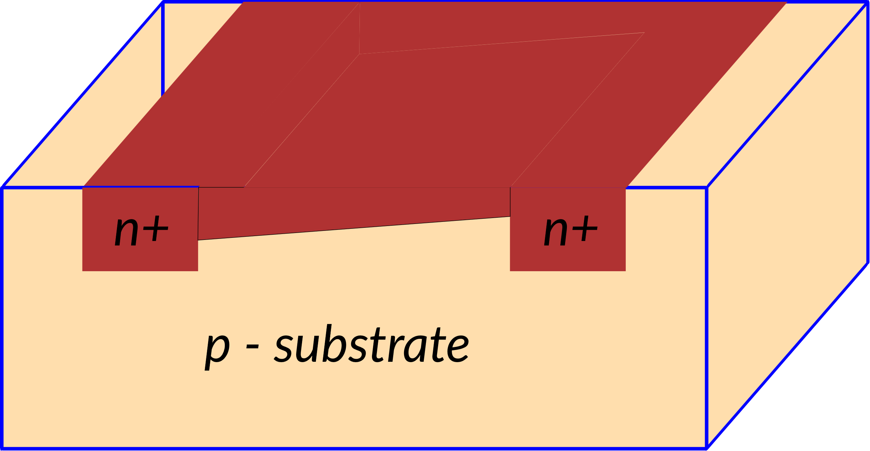
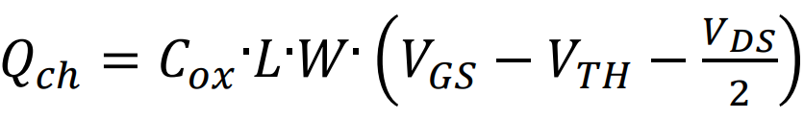
Derivation of I-V Characteristics
3. Drain Current at the linear, or triode, region. (As VDS is increased, the charge channel narrows at the drain end)
VDS modifies the voltage, and, the charge along the channel.
The voltage component due to VDS is maximum at the drain end, while it is zero at the Source end.
Suppose a linear distribution of the voltage component due to VDS along the channel, its average value can be approximately estimated to be VDS/2.
Then, a more accurate calculation of the channel charge can be obtained by adding VDS/2 in the charge expression
(C)
A more accurate calculation of the IDS current in linear region is also possible:
Drain Current at the linear, or triode, region.
(D)

Slide 31
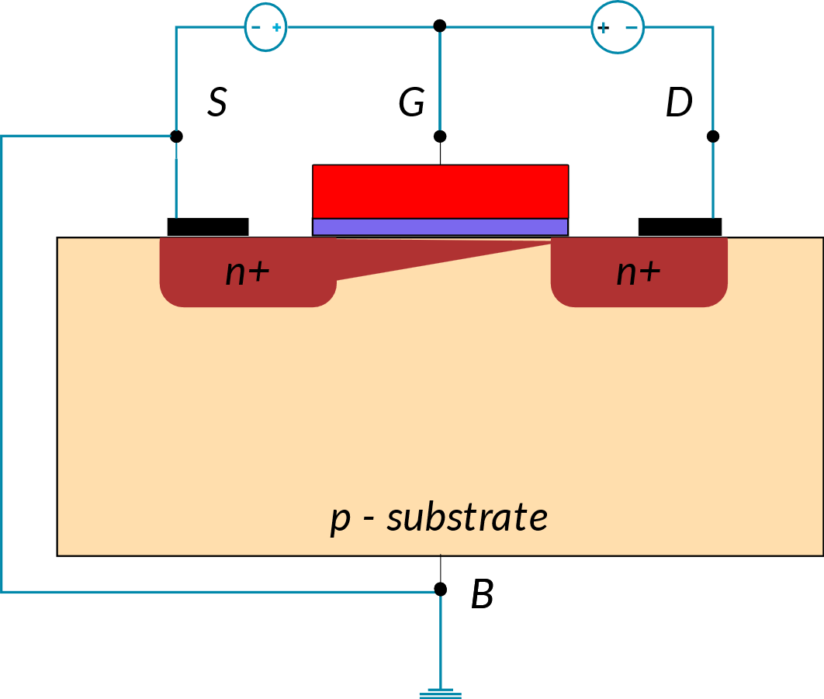
Derivation of I-V Characteristics
4. Drain Current at Saturation Region (As VDS approaches VGS‐VTH, )
As VDS approaches VGS‐VTH, the channel charge approaches zero at the Drain end.
When VDS compensates for the overdrive voltage VGS‐VTH, VGD results to be equal to the threshold voltage VTH
(E)
In this bias condition, no channel charge is available at the Drain end. The conducting channel pinches‐ off, disconnecting the Drain.
The VDS value that produces the channel pinch‐off is called saturation voltage (VDS,sat).
Substituting the VDS value in equation A, the expression of the IDS at the pinch‐off is obtained:
(F)
Therefore, when VDS increases, this depletion region enlarges, and the pinch‐off point moves toward the Source.
For your reference, Eq. A

Slide 32
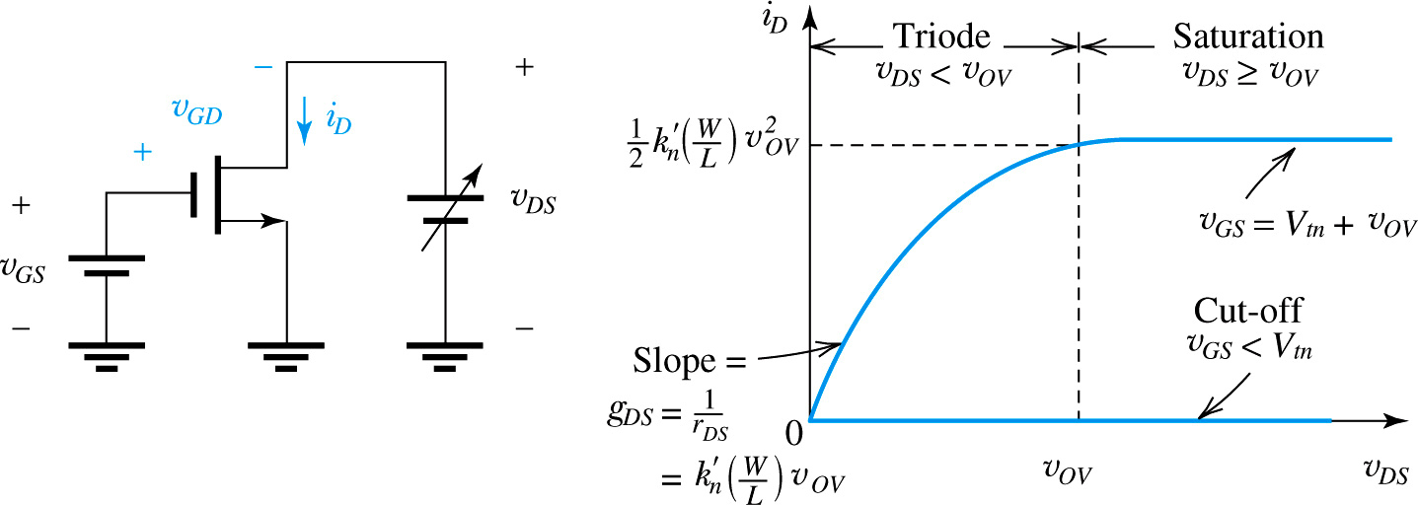
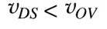
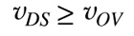
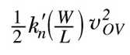
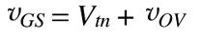
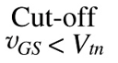
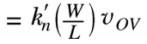
Current-voltage characteristics
The characteristics can be measured at dc or at low frequencies and thus are called static characteristics.
The dynamic effects that limit the operation of the MOSFET at high frequencies and high switching speeds.
where k’_{n} , g_{DS} , and r_{DS} are process transconductance parameter, channel conductance, and linear resistance, respectively.

Slide 33
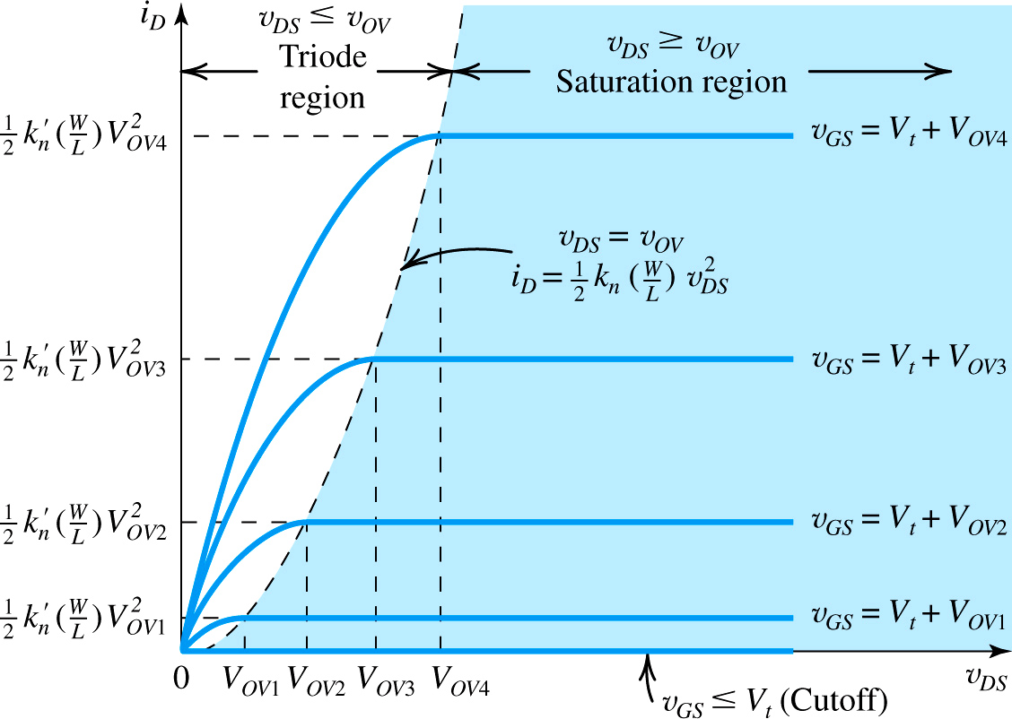
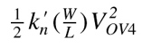
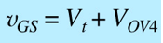
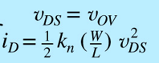
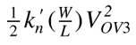
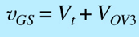
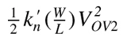
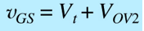
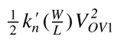
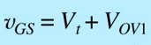
Fig. 13 The drain current versus the drain-to source voltage for an enhancement type NMOS transistor.

Slide 34


Slide 35
Second Order Effects:
Following are the list of second order effects of MOSFET.
Channel length modulation
Velocity Saturation
Mobility Degradation
Threshold voltage – Body effect
Subthreshold region
Drain Punchthrough
Impact Ionization – Hot Electrons

Slide 36



Channel Length Modulation
The length of the channel changes with changing values of VDS.
As the value of VDS is increased, it causes the depletion region of the Drain junction to grow.
This reduces the length of the channel which impacts current. The model current equation must be modified to
In general, lambda is proportional to channel length.
The effects of channel length modulation become more pronounced for smaller feature sizes.
Thus, when a high impedance current source is required, longer channel transistors are used.

Slide 37


Channel Length Modulation
This phenomenon yields a larger drain current as V_{DS} increases because I_{D} ∝ 1/L₁

Slide 38
Velocity Saturation
Carrier velocity increases with increasing electric fields.
V= μE
At high electric fields (V_{DS}), carrier mobility degrades, eventually leading to a constant velocity.
However, once the critical lateral electric field is reached, the velocity of the carriers does not increase any further.
This is caused by an increased rate of collision and carrier scattering.
The current does not increase at the expected rate. Rather, the current increases very little.
Owing to their very short channels (e.g., 0.1 μm), modern MOS devices experience velocity saturation even with drain-source voltages as low as 1 V.

Slide 39
Mobility Degradation
With increasing VGS, vertical electric fields increase.
This increase causes a rise in the number of carrier collisions, which degrades carrier mobility.
The current flowing through the transistor is expected by the ideal models.
Mobility decreases with increasing temperature.

Slide 40

Body Effect
In MOSFETs, we have assumed that both the source and the substrate (also called the “bulk” or the “body”) are tied to ground.
However, this condition need not hold in all circuits.
If the source terminal rises to a positive voltage while the substrate is at zero, then the source-substrate junction remains reverse-biased and the device still operates properly.
An interesting phenomenon occurs as the source-substrate potential difference departs from zero:
The threshold voltage of the device changes.
In particular, as the source becomes more positive with respect to the substrate, V_{TH} increases. Called “body effect,”

Slide 41


MOSFET Device Models
Small Signal Model Analysis
In the small-signal model, there is an output resistance r₀ and the current source is g_{m}V_{gs},
so if we can find the Transconductance (g_{m}), we can find the value of current in this circuit.
Output resistance r₀ is the fluctuation of drain-source voltage to current.

Slide 42







MOSFET Device Models

Slide 43




MOSFET Transconductance

Slide 44

Input Resistance
The gate of an MOS transistor is insulated from the channel by the SiO2 dielectric
The low-frequency gate current is essentially zero and the input resistance is essentially infinite.
Output Resistance
where V_{A} is the Early voltage, λ is the channel-length modulation parameter, I_{D} is the drain current without channel-length modulation, and r_{o} is the small-signal output resistance of the transistor.

Slide 45



Numerical
the intrinsic gain, g_{m}r_{O} , is equal to 20

Slide 46



MOSFET Device Models
Large Signal Model Analysis

Slide 47
Contents
Introduction of MOSFET Amplifiers –
Common Source (CS),
Common Gate (CG) and
Common Drain (CD) Amplifiers,
Their brief characteristics, pros and cons

Slide 48



The MOSFET Amplifier
The linear amplifiers are necessary in analog electronic system.
The term small signal means linearization of the ac equivalent circuit.
The linear amplifier means the use of superposition.
The various possible configurations of MOSFET amplifiers is considered
The Three Basic Configurations
(a) Common Source (CS)
(b) Common Gate (CG)
(c) Common Drain (CD)

Slide 49




Characterizing Amplifiers
Find gain, input and output resistance
An amplifier fed with a signal source having an open-circuit voltage v_{sig} and an internal resistance R_{sig}.
The input resistance R_{in} represents the loading effect of the amplifier input on the signal source.
(a)
(1)
(b)
(2)
Fig. 1(a) An amplifier fed with a voltage signal vsig having a source resistance Rsig, and feeding a load resistance RL; (b) Equivalent-circuit;

Slide 50






The second parameter is the open-circuit voltage gain A_{vo}
(3)
The overall voltage gain G_{v}
The third parameter is the output resistance R_{o},
(7)
(4)
The controlled source A_{vo}v_{i} and the output resistance R_{o} represent the Thévenin equivalent of the amplifier output circuit, and the output voltage can be expressed as
(8)
(5)
Thus the voltage gain of the amplifier, A_{v} , can be found as
(6)

Slide 51



The Common-Source (CS) Amplifier
Of the three basic MOS amplifier configurations, the common source is the most widely used.
Characteristic Parameters of the CS Amplifier
(a)
Replacing the MOSFET with its hybrid- model, we obtain the CS amplifier equivalent circuit shown in Fig. 2(b).
We shall use this equivalent circuit to determine the characteristic parameters R_{in}, A_{vo}, and R_{o},
(b)
(9)
Fig. 2(a) common source amplifier circuit and (b) MOSFET replaced with its hybrid π-model

Slide 52



The Common-Source (CS) Amplifier
The output voltage v_{o} is found by multiplying the current (g_{m}v_{gs}) by the total resistance between the output node and ground,
(10)
Since v_{gs} = v_{i}, the open-circuit voltage gain A_{vo} ≡ v_{o}/v_{i} can be obtained as
(11)
Observe that the transistor output resistance r_{o} reduces the magnitude of the voltage gain.
R_{D} is usually much lower than r_{o} and the effect of r_{o} on reducing |A_{vo}| is slight. Thus in many case we can neglect r_{o}
(12)

Slide 53


The Common-Source (CS) Amplifier
Overall Voltage Gain:
If a load resistance R_{L} is connected to the output terminal of the amplifier, this resistance will appear in parallel with R_{D}.
(13)
This expression together with the fact that , v_{i} = v_{sig} provides the overall voltage gain,
Fig. 2(b)
(14)

Slide 54


The Common-Source (CS) Amplifier
The output resistance R_{o} is the resistance seen looking back into the output terminal with v_{i} set to zero.
From Fig. 2(b) we see that with v_{i} set to zero, will be zero, v_{gs} will be zero, and thus g_{m}v_{gs} will be zero, resulting in
(15)
Here, r_{o} has the beneficial effect of reducing the value of R_{o}. In discrete circuits, this effect is slight and we can make the approximation
(16)
(Fig. 2(b))

Slide 55






The Common Gate (CG) Amplifier
(a)
Fig. 3(a) CG amplifier circuit and (b) MOSFET replaced with its T model
(b)
From inspection of the equivalent circuit of Fig. 3(b), we see that the input resistance
and substitute for the source current i from
(17)
(19)
To determine the voltage gain A_{vo}, we write at the drain node
To obtain
(20)
(18)

Slide 56



The Common Gate (CG) Amplifier
The output resistance of CG
(21)
which is the same as in the case of the CS amplifier
The gain of the CG amplifier has the same magnitude as that of the CS amplifier,
(22)
The signal transmission factor v_{i}/v_{sig} can be very small and the overall voltage gain G_{v} can be correspondingly small.
Fig. 3(b)
and
(23)

Slide 57



Common-Drain (CD) Amplifier
The common drain amplifier commonly known as the source follower.
Fig. 4 (a) Common-drain amplifier (b) Equivalent circuit of the source follower obtained by replacing the MOSFET with its T model. Note that r_{o} appears in parallel with R_{L} and in discrete circuits, r_{o}>>R_{L} . Neglecting r_{o}, we obtain the simplified equivalent circuit in (c).

Slide 58






The characteristics Parameters of the Source Follower
Since the MOSFET has a resistance R_{L} connected in its source terminal, it is most convenient to use the T model, as shown in Fig. 4(b)
A_{v} can be obtained from the voltage divider formed by 1/g_{m} and R_{L} as
(24)
Setting
, we obtain
(25)
The output resistance R_{o} is found by setting v_{i} = 0
(26)
The overall voltage gain:
(27)
Fig. 4(b)

Slide 59

Fig. 2
Fig. 3
Fig. 4
Fig. 1(a)

Slide 60
Properties of CS, CG, and CD amplifier
1. Common source
high input impedance, low output impedance, high gain, BW varies inversely with gain. Common voltage amplifier circuit.
2. Common gate
low input impedance, low output impedance, low gain, high BW, unity current gain. Common current regulator circuit.
3. Common drain (also called source follower)
high input impedance, low output impedance, unity voltage gain, high BW. Common voltage buffer circuit, impedance matching, simple output stage.

Slide 61
Contents
The CS and CE amplifiers with Current source load
Determination of intrinsic gain,
Effect of output resistance of the current source load

Slide 62
The CS and CE amplifiers with Current source load
The basic gain cell in an IC amplifier is a common-source (CS) or common-emitter (CE) transistor loaded with a constant-current source.
we have replaced the resistances R_{D} and R_{C} (from CS and CE) with constant-current sources.
Due to difficult in IC technology to implement resistances with reasonably precise values.
It is much easier to use current sources, which are implemented using transistors
Using a constant current source, we are in effect operating the CS and CE amplifiers with a very high load resistance; thus we can obtain a much higher gain.

Slide 63




(a)
Figure 1 The basic gain cells of IC amplifiers: (a) current-source- or active-loaded common-source amplifier; (b) current-source- or active-loaded common-emitter amplifier; (c) small-signal equivalent circuit of (a); and (d) small-signal equivalent circuit of (b).
(c)
(b)
(d)

Slide 64

Active-loaded common-source amplifier
Small-signal analysis of the current-source-loaded CS amplifier can be performed by utilizing their equivalent-circuit models,
From Fig. 1(b) we obtain for the active-loaded CS amplifier:
Since the current-source load is assumed to be ideal, it is represented in the models by an infinite resistance.
(b)
Figure 1 The basic gain cells of IC amplifiers: (a) active-loaded common-source amplifier (b) small-signal equivalent circuit
(a)

Slide 65

Active-loaded common-emitter amplifier
Small-signal analysis of the current-source-loaded CE amplifier can be performed by utilizing their equivalent-circuit models,
From Fig. 2(b) we obtain for the active-loaded CE amplifier:
(a)
(b)
Thus both circuits realize a voltage gain of magnitude g_{m}r_{o}. Since this is the maximum gain obtainable in a CS or CE amplifiers.
Figure 2 The basic gain cells of IC amplifiers: (a) active-loaded common-source amplifier (b) small-signal equivalent circuit

Slide 66






Recall from our study of the MOSFET; there are three possible expressions for g_{m}. Two of these are particularly useful here
and
(3)
For the MOSFET r₀ we have
(4)
where V_{A} is the Early voltage and V’_{A} is the technology-dependent component of the Early voltage.
Utilizing each of the g_{m} expressions together with the expression for , we obtain for A₀
, Alternatively
(5)
and
(6)

Slide 67









Numerical

Slide 68


Slide 69

Assignment

Slide 70



Effect of the Output Resistance of the Current-Source Load
The current-source load of the CS amplifier in Fig. 1(a) can be implemented using a PMOS transistor biased in the saturation region to provide the required current I, as shown in Fig. 4(a).
(a)
(b)
(c)
Figure 4 (a) The CS amplifier with the current-source load implemented with a p-channel MOSFET Q₂; (b) the circuit with Q₂ replaced with its large-signal model; and (c) small-signal equivalent circuit of the amplifier.

Slide 71




We can use the large-signal MOSFET model to model as shown in Fig. 4(b), where
(7)
and
(8)
Thus the current-source load no longer has an infinite resistance; rather, it has a finite output resistance r_{o2}.
This resistance will in effect appear in parallel with r_{o1} , as shown in the amplifier equivalent-circuit model in Fig. 4(c), from which we obtain
(9)
For instance, if Q₂ has an Early voltage equal to that of Q₁, r_{o2} = r_{o1} and the gain is reduced by half,
(10)

Slide 72
Contents
The Cascode Amplifier – Cascoding,
The MOS Cascode Amplifier

Slide 73

The Cascode Amplifier – Cascoding,
Cascoding refers to the use of a transistor connected in the common-gate (or the common-base) configuration to provide current buffering for the output of a common-source (or a common- emitter) amplifying transistor.
In Fig. 1, the transistor CS Q1 is the amplifying transistor and Q2, connected in the CG configuration with a dc bias voltage V_{G2} (signal ground) at its gate, is the cascode transistor.
The CG amplifier characteristics, we can see that the cascode transistor passes the current g_{m1}v_{i} to the output node.
while multiplying the resistance in its source (r_{o1}of Q₁) by a factor K.
Figure 1 illustrates the technique for the MOS case.
The result is the equivalent circuit of Fig. 1, which can be utilized to determine the voltage gain of the cascode amplifier for various load resistances.

Slide 74







The MOS Cascode Amplifier
Since the load is an ideal constant-current source, the load resistance is infinite.
The amplifier is operating with an open-circuit load, and the gain is
(1)
Now, since R_{s} of Q₂ is r_{o1}, the output resistance R_{o} is given by the approximate expression
(2)
Substituting in Eq. (1) results in
(b)
(3)
For the case g_{m1} = g_{m2} = g_{m} and r_{o1} = r_{o2} = r_{o},
(4)
(a)
Thus cascoding increases the gain magnitude from A₀ to A²₀.
Figure 2 (a) A MOS cascode amplifier with an ideal current-source load; (b) equivalent circuit representation of the cascode output.

Slide 75





Implementation of the Constant-Current Source Load
If the current source load is implemented with a PMOS transistor (which can be part of a PMOS current mirror) as shown in Fig. 3(a), the load resistance R_{L} will be equal to the output resistance of Q₃, r_{o3},
(5)
and the voltage gain of the cascode amplifier will be
(6)
(b)
since R_{L} << R_{o}, the total resistance will be approximately equal to r_{o3} and the gain will be
Figure 3 (a) A MOS cascode amplifier loaded in a simple PMOS current sourceQ3. (b) Equivalent circuit
at the amplifier output.
(7)
Thus the gain magnitude will be back to A₀, of the same order as that realized by a CS amplifier.
A major advantage over the CS circuit: It exhibits a much wider bandwidth.
(a)

Slide 76


The Use of a Cascode Current Source
To realize a gain of the order of A²₀, the load resistance R_{L} must be of the same order as R_{o} of the cascode amplifier.
This can be achieved by using a cascode current source as shown in Fig. 4.
Here Q₄ is the current-source transistor, and Q₃ is the CG cascode transistor.
Voltages V_{G3} and V_{G4} are dc bias voltages.
The cascode transistor Q₃ multiplies the output resistance of Q₄, r_{o4} by (g_{m3}r_{o3}) to provide an output resistance for the cascode current source of
(8)
Figure 4 Employing a cascode transistor Q3 to raise the output resistance of the current source Q4.

Slide 77




The Use of a Cascode Current Source
Combining a cascode amplifier with a cascode current source results in the circuit of Fig. 5(a).
The equivalent circuit at the output side is shown in Fig. 5(b), from which the voltage gain can be easily found as
(9)
(10)
Figure 5 A cascode amplifier with a cascode current-source load.
For the case in which all transistors are identical,
(11)

Slide 78




Distribution of Voltage Gain in a Cascode Amplifier
It is often useful to know how much of the overall voltage gain of a cascode amplifier is realized in each of its two stages: the CS stage Q1, and the CG stage Q2.
In Fig. 6(a), we have included a load resistance R_{L}, which represents the output resistance of the current-source load plus any additional resistance that may be connected to the output node.
The voltage gain Av of the amplifier can be found as
(12)
(13)
(a)
(b)
Figure 6 (a) The cascode amplifier with a load resistance R_{L}. Only signal quantities are shown. (b) Determining v_{o1}.

Slide 79





Distribution of Voltage Gain in a Cascode Amplifier
The overall gain A_{v} can be expressed as the product of the voltage gains of Q₁ and Q₂ as
(14)
To obtain A_{v1} ≡ v_{o1}/v_{i} we need to find the total resistance between the drain of Q1 and ground.
Referring to Fig. 6(b) and denoting this resistance R_{d1}, we can express A_{v1} as
(15)
Observe that R_{d1} is the parallel equivalent of r_{o1} and R_{in2}, where R_{in2} is the input resistance of the CG transistor Q₂.
From previous expression
Old expression from previous lecture
we can write
(16)
Now we can obtain R_{d1} as
(b)
(17)
Figure 6 (b) Determining v_{o1}.

Slide 80

Distribution of Voltage Gain in a Cascode Amplifier
and A_{v1} as
(18)
Finally, we can obtain A_{v2} by dividing the total gain A_{v} given by Eq. (13) by A_{v1}.
To provide insight into the effect of the value of R_{L} on the overall gain of the cascode as well as on how this gain is distributed among the two stages of the cascode amplifier.
We provide in Table 1 approximate values for the case r_{o1}= r_{o2}= r_{o} and
For four different values of R_{L}:
(1) R_{L} =∞, obtained with an ideal current-source load;
Table 1
(2) R_{L} = (g_{m}r_{o})r_{o}, obtained with a cascode current-source load;
(3) R_{L}= r_{o}, obtained with a simple current-source load;
(4) for completeness, R_{L}= 0, that is, a signal short circuit at the output.

Slide 81
Contents
IC Biasing – Current Sources and Current Mirrors
Problem example

Slide 82
IC Biasing
Biasing in IC design is based on constant-current sources
Avoid resistors on IC (issues: chip area, tolerance)
Problem: How to create stable current source
On IC we may have multiple amplifier stages
Reference DC current is generated at on CM and is copied at other locations for biasing
This is known as Current steering
Solution: Current Mirrors (CM)
Furthermore, the bias currents of the various stages track each other in case of changes in power-supply voltage or in temperature.

Slide 83




IC Biasing: Current Source Circuit
For transistor Q₁, the drain is shorted to its gate, forcing it to operate in the saturation mode with
(1)
The drain current of Q₁ is supplied by V_{DD} through resistor R, which in most cases would be outside the IC chip. Since the gate currents are zero,
(2)
Now consider transistor Q₂:
Since V_{GS1} = V_{GS2} = V_{GS} :
(3)
Fig. 1 Basic MOSFET Constant Current Source

Slide 84


IC Biasing: Current Mirror Source Circuit
Relation between the output current I_{O} to the reference current I_{REF} is determined by geometry of the transistors as follows:
(4)
The ration is known as Current Gain or Current Transfer Ration
For identical transistors, I_{o} = I_{REF} and the circuit simply replicates or mirrors the reference current in the output terminal.
Therefore, circuit composed of Q₁ and Q₂ is called as current mirror
Fig. 1 Basic MOSFET Constant Current Mirror

Slide 85



IC Biasing: Current Source Circuit
If considering channel length modulation, I_{O} vary slightly with V_{O}
Fig. 2: Output characteristic (R_{O}) of the current source and current mirror circuits
Fig.1 Basic MOSFET Constant Current Source

Slide 86

Problem Statement 1:
Design the circuit of Figure 1, that is, determine the values of R_{D} and R_{S} – so that the transistor operates at I_{D} = 0.4mA and V_{D} = +0.5V.
The NMOS transistor has V_{t} = 0.7V, u_{n}C_{ox} = 100uA/V², L = 1um, and W = 32um.
Neglect the channel-length modulation effect (i. e. assume that l = 0).
Figure 1

Slide 87






Solution:
To establish a dc voltage of +0.5 V at the drain, we must select R_{D} as follows:
The saturation-region expression of I_{D} to determine the required value of V_{OV}, since V_{D} = 0.5 V is greater than V_{G}
which results in
we note that the gate is at ground potential. Thus, the source must be at −1.2 V, and the required value of R_{S} can be determined from

Slide 88

Problem Statement 2:
Design the circuit in Figure 2 to establish a drain voltage of 0.1V.
What is the effective resistance between drain and source at this operating point?
Let V_{tn} = 1V and k’_{n}(W/L) = 1mA/V².
Figure 2

Slide 89







Solution:
Since the drain voltage is lower than the gate voltage by 4.9 V and V_{tn} =1 V the MOSFET is operating in the triode region. Thus the current I_{D} is given by
The required value for R_{D} can be found as
Since the transistor is operating in the triode region with a small V_{DS}, the effective drain-to-source resistance can be determined as follows:

Slide 90
Example: 1
Given V_{DD} = 3 V and using I_{REF} =100 μA , design the circuit shown in figure 2 to obtain an output current whose nominal value is 100 μA.
Find R if Q₁ and Q₂ are matched and have channel lengths of 1 μm , channel widths of 10 μm , V_{t} = 0.7 V, and k_{n} = 200 μA/V².
What is the lowest possible value of V_{O} ? Assuming that for this process technology, the Early voltage V_{A} =20 V/μm , find the output resistance of the current source.
Also, find the change in output current resulting from a + 1 V change in V_{O} .
Fig. 2 Current Source circuit

Slide 91








Solution:
Given V_{DD} = 3 V and using I_{REF} =100 μA , design the circuit shown in figure 2 to obtain an output current whose nominal value is 100 μA.
Find R if Q₁ and Q₂ are matched and have channel lengths of 1 μm , channel widths of 10 μm , V_{t} = 0.7 V, and k_{n} = 200 μA/V².
What is the lowest possible value of V_{O} ? Assuming that for this process technology, the Early voltage V_{A} =20 V/μm , find the output resistance of the current source.
Also, find the change in output current resulting from a + 1 V change in V_{O}
Therefore,
The output current will be 100 μA at V_{O} = V_{GS} = 1 V.
If V_{O} changes by +1 V, the corresponding change in I_{O} will be

Slide 92
Example: 2
In the current source of Example 1, it is required to reduce the change in output current, ΔI_{O}, corresponding to a change in output voltage, ΔV_{O}, of 1 V to 1% of I_{O}.
What should the dimensions of Q₁ and Q₂ be changed to?
Assume that Q₁ and Q₂ are to remain matched.
Fig. 2 Current Source circuit

Slide 93







Solution: 2
In the current source of Ex. 1, we have I_{O}= 100 µA
To keep V_{OV} of the matched transistors the same as that in Ex. 1, W/L of the transistor should remain the same.
Therefore,
So the dimensions of the matched transistors Q₁ and Q₂ should be changed to

Slide 94
Example: 3
For V_{DD} =1.3 V and using I_{REF}=100 μA, it is required to design the circuit of Fig. 3 to obtain an output current whose nominal value is 100 μA.
Find R if Q1 and Q2 are matched with channel lengths of 0.5 μm, channel widths of 5 μm, V_{t}= 0.4 V, and k’_{n}= 500 μA/V².
What is the lowest possible value of V_{O}?
Assuming that for this process technology the Early voltage V’_{A}=5 V/μm, find the output resistance of the current source.
Also, find the change in output current resulting from a +0.5 V change in V_{O}.
Fig. 3 Current Source circuit

Slide 95








Solution: 3
The lowest V_{o} will be
Therefore,
If V_{O} changes by +0.5 V, the corresponding change in I_{O} will be

Slide 96
Example: 4
Sketch the p-channel counterpart of the current-source
circuit of Fig. 5. Note that while the circuit of Fig. 5 should more appropriately be called a current sink, the corresponding PMOS circuit is a current source.
Let V_{DD} = 1.3 V, V_{t}= 0.4 V, Q₁ and Q₂ be matched, and μ_{p}C_{ox} = 80 μA/V².
Find the device W/L ratios and the value of the resistor that sets the value of I_{REF} so that a nominally 80-μA output current is obtained.
The current source is required to operate for V_{O} as high as 1.1 V. Neglect channel-length modulation.
Fig. 5 Current Source circuit

Slide 97








Solution: 4
Set
Thus

Slide 98
Example: 5
Consider the current-mirror circuit of Fig. 6 with two transistors having equal channel lengths but with Q₂ having a width five times that of Q₁.
If I_{REF} is 20 μA and the transistors are operating at an overdrive voltage of 0.2 V, what I_{O} results?
What is the minimum allowable value of V_{O} for proper operation of the current source? If V_{t} = 0.5 V, at what value of V_{O} will the nominal value of I_{O} be obtained?
If V_{O} increases by 1 V, what is the corresponding increase in I_{O}? Let V_{A}= 20 V.
Fig. 6 Constant Current Mirror

Slide 99





Solution: 5
If W₂ = 5W₁ and we let L₁ = L₂, then we obtain
Thus, I_{D} equal 5 I_{REF} will be obtained at
The corresponding increase in I_{o}, ΔI_{o} is 5 µA

Slide 100
Contents
Differential Amplifiers: MOS Differential Pair

Slide 101
Introduction
The differential-pair of differential-amplifier configuration is widely used in IC circuit design.
One example is input stage of op-amp.
Another example is emitter-coupled logic (ECL).
Technology was invented in 1940’s for use in vacuum tubes – the basic differential-amplifier configuration was later implemented with discrete bipolar transistors.
However, the configuration became most useful with invention of modern transistor / MOS technologies.

Slide 102

The MOS Differential Pair
Two matched transistors (Q₁ and Q₂) joined and biased by a constant current source I.
FET’s should not enter triode region of operation for any type of loading condition.
Figure 1: The basic MOS differential-pair configuration.

Slide 103

Operation with a Common-Mode Input Voltage
Consider case when two gate terminals are joined together.
Connected to a common-mode voltage (V_{CM}).
v_{G1} = v_{G2} = V_{CM}
Since Q₁ and Q₂ are matched.
Current I will divide equally between the two transistors.
I_{D1} = I_{D2} = I/2, V_{S} = V_{CM} – V_{GS}
where V_{GS} is the gate-to-source voltage.
(1)
Figure 2: The MOS differential pair with a common-mode input voltage V_{CM}

Slide 104


Operation with a Common-Mode Input Voltage
Neglecting channel-length modulation, V_{GS} and I/2 are related by
(2)
(3)
(4)
(5)
(6)
Now, let us vary the value of the common-mode voltage V_{CM}.
We see that, as long as Q₁ and Q₂ remain in the saturation region, the current I will divide equally between Q₁ and Q₂ and the voltages at the drains will not change.
Figure 2: The MOS differential pair with a common-mode input voltage V_{CM}

Slide 105

Operation with a Differential Input Voltage
If v_{id} is applied to Q₁ and Q₂ is grounded, following conditions apply:
v_{id} = v_{GS1} – v_{GS2} > 0
i_{D1} > i_{D2}
When v_{id} is negative, v_{GS1} will be lower than v_{GS2}, i_{D1} will be smaller than i_{D2}, and correspondingly v_{D1} will be higher than v_{D2};
In other words, the difference or differential output voltage (v_{D2} – v_{D1}) will be negative.
The differential pair responds to a difference-mode or differential input signals.
Figure 3: The MOS differential pair with a differential input signal v_{id} applied.

Slide 106






Operation with a Differential Input Voltage
In the positive direction, when v_{GS1} reaches the value that corresponds to i_{D1} = I, and v_{GS2} is reduced to a value equal to the threshold voltage V_{t} , at which point v_{S} =−V_{t} . The value of v_{GS1} can be found from
where V_{OV} is the overdrive voltage corresponding to a drain current of I/2.
Thus, the value of v_{id} at which the entire bias current I is steered into Q₁ is
If v_{id} is increased beyond √2V_{OV} , i_{D1} remains equal to I, v_{GS1} remains equal to (V_{t}+√2V_{OV} ), and v_{S} rises correspondingly, thus keeping Q₂ off.
Figure 3: The MOS differential pair with a differential input signal v_{id} applied.

Slide 107
Example: 1
For the MOS differential pair with a common-mode voltage V_{CM} applied, as shown in Fig. 4, let V_{DD} = V_{SS} = 1.5 V, k’_{n}(W/L) = 4mA/V², V_{t}= 0.5 V, I = 0.4 mA, and R_{D} = 2.5 kΩ, and neglect channel-length modulation. Assume that the current source I requires a minimum voltage of 0.4 V to operate properly.
(a) Find V_{OV} and V_{GS} for each transistor.
(b) For V_{CM} = 0, find V_{S} , I_{D1}, I_{D2}, V_{D1}, and V_{D2}.
(c) Repeat (b) for V_{CM} =+1 V.
(d) Repeat (b) for V_{CM} =−0.2 V.
Fig. 4

Slide 108




Solution 1:
(a) With v_{G1} = v_{G2} = V_{CM}, we see that V_{GS1} = V_{GS2}. Now, since the transistors are matched, I will divide equally between the two transistors,
and
and

Slide 109




Solution 1:
(b) For V_{CM} = 0, find V_{S} , I_{D1}, I_{D2}, V_{D1}, and V_{D2}.
(b) The analysis for the case V_{CM} = 0 is shown in Fig. 4 (a) from which we see that
and
V_{G}
V_{S}
V_{GS}
and
Fig. 4 (a)

Slide 110


Solution 1:
(c) Repeat (b) for V_{CM} =+1 V.
(c) The analysis for the case V_{CM} = +1 V is shown in Fig. 4(b) from which we see that
and
V_{G}
and
V_{S}
V_{GS}
Observe that the transistors remain in the saturation region as assumed. Also observe that I_{D1}, I_{D2}, V_{D1}, and
V_{D2} remain unchanged even though the common-mode voltage V_{CM} changed by 1 V.
Fig. 4 (b)

Slide 111

Solution 1:
Repeat (b) for V_{CM} =−0.2 V.
(d) The analysis for the case V_{CM} = − 0.2 V is shown in Fig. 4(c), from which we see that
It follows that the current source I now has a voltage across it of
which is greater than the minimum required value of 0.4 V. Thus, the current source is still operating properly and delivering a constant current I = 0.4 mA and hence
V_{G}
V_{S}
V_{GS}
and
and
So, here again the differential circuit is not responsive to the change in the common-mode voltage V_{CM}.
Fig. 4 (b)

Slide 112
Neil Waste Book

Slide 113
Static CMOS Design
In order to take advantage of static CMOS, need to learn implementation of AND and OR logic in terms of NAND and NOR gate
Using bubble technique implementation is less complex.
Compound gates are particularly useful to perform complex functions with relatively low logical efforts.
focused on building gates with equal rising and falling delays;
Using smaller pMOS transistors can reduce power, area, and delay.

Slide 114


Bubble Pushing
AND and OR functions must be built from NAND and NOR gates.
DeMorgan’s law helps with this conversion:
A NAND gate is equivalent to an OR of inverted inputs.
A NOR gate is equivalent to an AND of inverted inputs.
The same relationship applies to gates with more inputs.

Slide 115
Design a circuit to compute F = AB + CD using NANDs and NORs.

Slide 116





Slide 117
Logic Effort
In general, the normalized delay of a gate (d) as a process independent unit has two components.
A fixed part called parasitic delay p due to the internal capacitance, when gate driving no load.
Other part proportional to the load on the output called the effort delay or stage effort f
Total delay is measured in units of τ, and is sum of these delays that can be expressed as
d = f + p
f is the effort delay or stage effort that depends on the complexity and fanout of the gate:
f = g×h
Where fanout or electrical effort h.
Where logical effort, g.

Slide 118
LOGIC EFFORT:
The complexity is represented by the logical effort, g.
Logical effort (g) of a gate is defined as the ratio of the input capacitance (C_{in,gate}) of the gate to the input capacitance of an inverter (C_{in,unit_inv}) that can deliver the same output current.
g = C_{in,gate} /C_{in,unit_inv}
An inverter is defined to have a logical effort of 1. More complex gates have greater logical efforts, indicating that they take longer to drive a given fanout.

Slide 119

LOGIC EFFORT:
A gate driving h identical copies of itself is said to have a fanout or electrical effort of h.
If the load does not contain identical copies of the gate, the electrical effort can be computed as
where Cout is the capacitance of the external load being driven and Cin is the input capacitance of the gate.
So, the total delay can further expressed as
d = g*h + p
Where, p = C_{intinsic,gate}/C_{intrinsic,inv}

Slide 120

Parasitic Delay
The parasitic delay of a gate is the delay of the gate when it drives zero load.
It can be estimated with RC delay models.
A crude method good for hand calculations is to count only diffusion capacitance on the output node.

Slide 121



EXAMPLE:
Estimate the logic effort g for the given circuits.

Slide 122


Slide 123









Slide 124


Slide 125



a circuit with a two way branch.
Consider a path from the primary input to one of the outputs.
The path logical effort G can be expressed as the products of the logical efforts of each stage along the path.
The path logical effort is G= g1x g2= (3/3)x(3/3)=1
The path electrical effort is
H = 90/5 = 18.
Thus, GH = 18.

Slide 126



The path effort F is the product of the stage efforts of each stage.
F = f1 f2 = (g1h1)(g2h2) = 1 × 6 × 1 × 6 = 36.
F = 2GH
The branching effort b is the ratio of the total capacitance seen by a stage to the capacitance on the path
=(15 + 15)/15 = 2
The path branching effort B is the product of the branching efforts between stages.

Slide 127

Logic effort for Hi-skew

Slide 128

Logic effort for Hi-skew
Reducing the logical effort on that critical transition to gu = 2.5/3 = 5/6.
The logical effort for the falling transition is estimated by comparing the inverter to a smaller unskewed inverter with equal pulldown current,
a logical effort of gd = 2.5/1.5 = 5/3.
Skewed gates are sometimes denoted with an H or an L on their symbol in a schematic.

Slide 129







Logic effort for Lo-skew

Slide 130

Ratioed Circuit
Ratioed circuits depend on the proper size or resistance of devices for correct operation.
The ratioed gate consists of an nMOS pulldown network and some pullup device called the static load

Slide 131

P/N Ratios
The average logical effort of the LO-skew NOR2 is actually better than that of the unskewed gate.
In general, what is the best P/N ratio for logic gates (i.e., the ratio of pMOS to nMOS transistor width)?
the ratio giving lowest average delay is the square root of the ratio that gives equal rise and fall delays.
For processes with a mobility ratio of μn/ μp = 2 as we have generally been assuming, the best ratios are shown in Figure

Slide 132
Reducing the pMOS size from 2 to √2=1.414 for the inverter gives the theoretical fastest average delay, but this delay improvement is only 3%.
However, this significantly reduces the pMOS transistor area.
It also reduces input capacitance, which in turn reduces power consumption.

Slide 133

Pseudo-nMOS
Neither high-value resistors nor depletion mode transistors are readily available as static loads in most CMOS
Instead, the static load is built from a single pMOS transistor that has its gate grounded so it is always ON.
Larger relative pMOS transistor sizes offer faster rise times but less sharp transfer characteristics.
The pulldown network is like that of an ordinary static gate, but the pullup network has been replaced with a single pMOS transistor that is grounded so it is always ON.

Slide 134






Pseudo-nMOS
The logical effort for each transition is computed as the ratio of the input capacitance to
that of a complementary CMOS inverter with equal current for that transition.
The pMOS transistor widths are selected to be about 1/4 the strength (i.e., 1/2 the effective width) of the nMOS pulldown network as a compromise between noise margin and speed
this best size is process-dependent, but is usually in the range of 1/3 to 1/6.
For example, the logical effort for a falling transition of the pseudo-nMOS inverter is the ratio of its input capacitance (4/3) to that of a unit complementary CMOS inverter (3), i.e., 4/9.
gu is three times as great because the current is 1/3 as much.

Slide 135
The parasitic delay is also found by counting output capacitance and comparing it to an inverter with equal current.
For example, the pseudo-nMOS NOR has 10/3 units of diffusion capacitance as compared to 3 for a unit-sized complementary CMOS inverter, so its parasitic delay pulling down is 10/9.
The pullup current is 1/3 as great, so the parasitic delay pulling up is 10/3.
As can be seen, pseudo-nMOS is slower on average than static CMOS for NAND structures.
However, pseudo-nMOS works well for NOR structures.

Slide 136



Cascode Voltage Switch Logic

Slide 137


Cascode Voltage Switch Logic

Slide 138

Cascode Voltage Switch Logic

Slide 139


Cascode Voltage Switch Logic

Slide 140


Cascode Voltage Switch Logic

Slide 141


Cascode Voltage Switch Logic

Slide 142

Dynamic Circuits
Ratioed circuits reduce the input capacitance by replacing the pMOS transistors connected to the inputs with a single resistive pullup.
The drawbacks of ratioed circuits include slow rising transitions, contention on the falling transitions, static power dissipation, and a nonzero VOL.
Dynamic circuits avoid these drawbacks by using a clocked pullup transistor rather than a pMOS that is always ON.

Slide 143


Dynamic circuit operation is divided into two modes, as shown in Figure
During precharge, the clock ɸ is 0, so the clocked pMOS is ON and initializes the output Y high.
During evaluation, the clock is 1 and the clocked pMOS turns OFF.
circuits are the fastest commonly used circuit family because they have lower input capacitance and no contention during switching.
They also have zero static power dissipation. However, they require careful clocking, consume significant dynamic power, and are sensitive to noise during evaluation.
The extra transistor is sometimes called a foot.

Slide 144


Slide 145

Domino Logic
The monotonicity problem can be solved by placing a static CMOS inverter between dynamic gates,
The dynamic-static pair together is called a domino gate
A single clock can be used to precharge and evaluate all the logic gates within the chain.

Slide 146


Dual-Rail Domino Logic
Dual-rail domino gates accept both true and complementary inputs and compute both true and complementary outputs,

Slide 147
NP and Zipper Domino
Assignments

Slide 148
Adders

Slide 149

Adders
Adder is a digital logic circuit that implements addition of binary numbers.
Adder’s circuit forms a basic component of ALU (Arithmetic Logic Unit).
Adder circuit is basically a combinational logic circuit.
It is a memory less circuit and performs an operation assigned to it
The output depends upon the present input at any given time.

Slide 150

Classification of Adders
Adders are broadly classified into two types. They are:
Half Adder
Full Adder
Multi-bit Adder
Half Adder
Half Adder is a combinational arithmetic circuit that adds two binary numbers and produces sum bit (S) and carry bit (C) as the output.
It is used to add 2 single-bit binary numbers.

Slide 151


Full Adder
It is a combinational arithmetic circuit constructed by combining two Half Adder circuits.
It is used to add 3 one-bit binary numbers.
Multi-bit Adder
Multi-bit Adders are constructed using Full Adders either Serially or in Parallel known as:
Serial Adder
Parallel Adder

Slide 152




FULL ADDER
Truth Table
Block Diagram

Slide 153

Carry look ahead adder
Carry Look Ahead Adder is an improved version of the ripple carry adder.
It generates the carry-in of each full adder simultaneously without causing any delay.
It is based on the fact that a carry signal will be generated in two cases:
(1) when both bits Ai and Bi are 1, or
(2) when one of the two bits is 1 and the carry-in (carry of the previous stage) is 1.

Slide 154


The output sum and carry can be defined as
G_{i} is known as the carry Generate signal since a carry (C_{i}+1) is generated whenever G_{i} =1, regardless of the input carry (C_{i}).
P_{i} is known as the carry propagate signal, whenever P_{i} =1, the input carry is propagated to the output carry, i.e., C_{i+1}. = C_{i}

Slide 155

The Boolean expression of the carry outputs of various stages can be written as follows:

Slide 156

The 4-bit carry look-ahead (CLA) adder consists of 3 levels of logic

Slide 157
First level: Generates all the P & G signals. Four sets of P & G logic (each consists of an XOR gate and an AND gate). Output signals of this level (P’s & G’s) will be valid after 1τ.
Second level: The Carry Look-Ahead (CLA) logic block which consists of four 2-level implementation logic circuits. It generates the carry signals (C1, C2, C3, and C4) as defined by the above expressions. Output signals of this level (C1, C2, C3, and C4) will be valid after 3τ.
Third level: Four XOR gates which generate the sum signals (Si) (Si = Pi ⊕ Ci). Output signals of this level (S0, S1, S2, and S3) will be valid after 4τ.

Slide 158
Advantages of Carry Look Ahead Adder
It generates the carry-in for each full adder simultaneously.
It reduces the propagation delay.
Disadvantages of Carry Look Ahead Adder-
It involves complex hardware
It is costlier since it involves complex hardware.
It gets more complicated as the number of bits increases.

Slide 159
Carry-Save adder
A carry-save adder is a type of digital adder, used to efficiently compute the sum of three or more binary numbers.
It differs from other digital adders in that it outputs two (or more) numbers, and the answer of the original summation can be achieved by adding these outputs together.
A carry save adder is typically used in a binary multiplier, since a binary multiplier involves addition of more than two binary numbers after multiplication.
A big adder implemented using this technique will usually be much faster than conventional addition of those numbers.

Slide 160

Three bit addition

Slide 161

Carry save adder

Slide 162

7-bit carry save addition

Slide 163
Clock Skew concept in detail
https://mahajankankit.medium.com/clock-skew-concept-1d5356620895

Slide 164
Thank you
..

